Slide 1
History of Iterative Methods
Ben van Schaijik

Slide 2
“One of the ways to help make computer science respectable is to show that it is deeply rooted in history…”
— Donald E. Knuth

Slide 3
Development flow
Ancient Discoveries
Gauss and Newton
To infinity and beyond

Slide 4
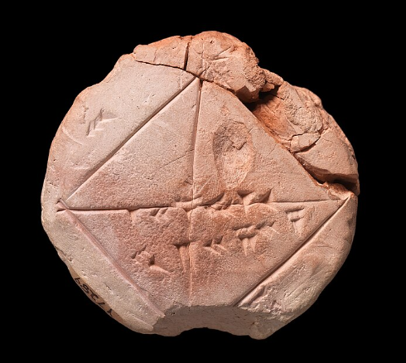
Iterative methods in the Ancient World
The Babylonian Tablet - YBC 7289
Finding the square root of 2
Markings indicate numbers corresponding to iterative additions to one
Utilized a base 60 numerical system
Circa 1800-1600 BC
HW 2 ?

Slide 5
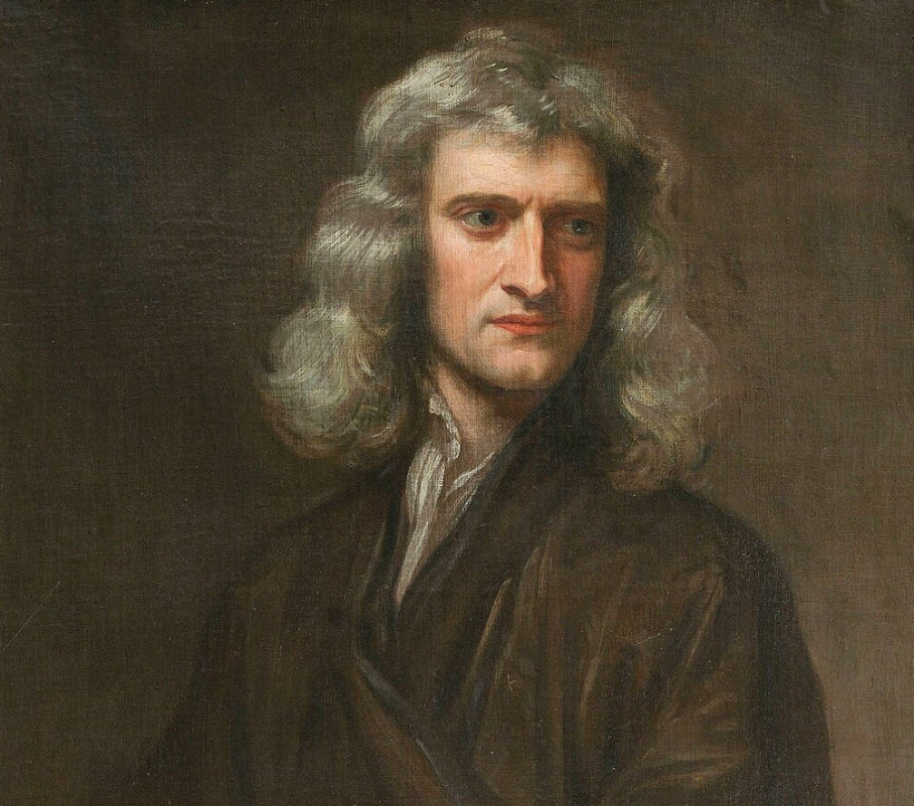
Isaac Newton
1643 – 1727
Hugely influential figure for mathematics, physics, mechanics, and more
Father dies before birth
Mother leaves him soon after
Diagnose
“On the Methods of Series and Fluxions”
University closed because of the Plague – Newton spends two years on his own furthering calculus, optics, and gravitation

Slide 6
Isaac Newton - the man
“Isaac Newton was not a pleasant man. His relations with other academics were notorious, with most of his later life spent embroiled in heated disputes.”
— S. Hawking

Slide 7
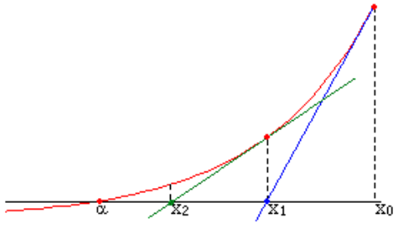
Isaac Newton - Newton’s Method?
Find a root using the derivative of the function
But…
Not clear who can take credit for what
Francois Vieta, Isaac Newton, Joseph Raphson, and Thomas Simpson developed related but separate strategies
Misconception that quadratic convergence means Newton’s method

Slide 8
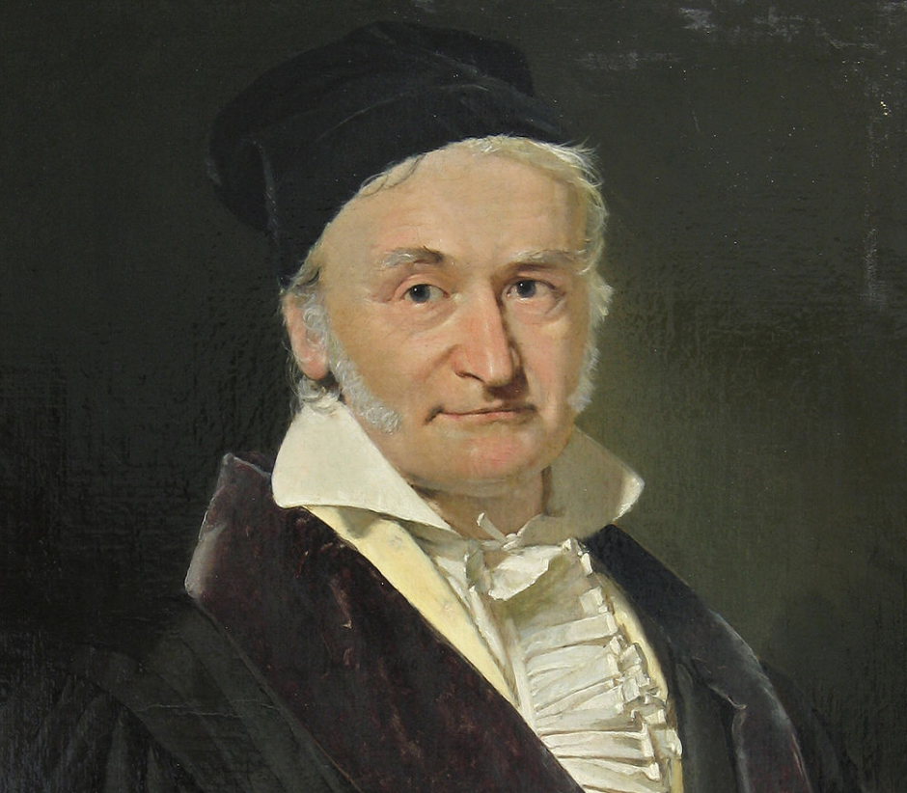
Carl Friedrich Gauss
1777 – 1855
German Mathematician famous for his work in astronomy, number theory, geometry, and more
helped invent the first electronic telegraph
Corresponded with many, but often kept his discoveries private
We know the…
Direct method Gaussian elimination
Iterative method, Gauss-Seidel method

Slide 9
“I recommend this method to you for imitation. You
will hardly ever again eliminate directly, at least not when you have more than 2
unknowns”
— Gauss (correspondence with Gerling)

Slide 10

Static Richardson
Conjugate Gradient
Dynamic Richardson
Jacobi
Multigrid method
Preconditioned Conjugate Gradient

Slide 11
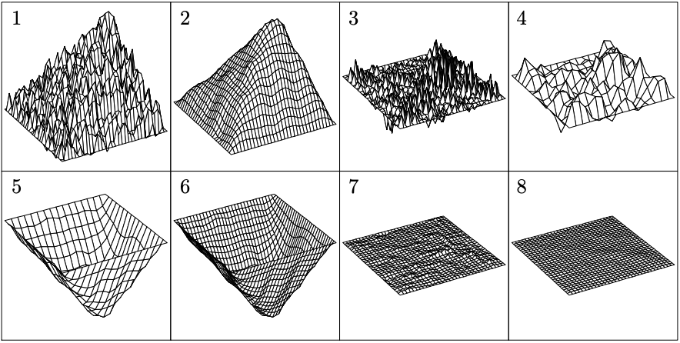
Source : LANDMARKS IN THE HISTORY OF ITERATIVE METHODS

Slide 12
Thank you!

Slide 13
Sources
Facts:
Source #1 - Main Source
Source #2 - Gauss’s method
Source #3 - Newton’s method credit
Source #4 - Gauss biographical information
Source #5 - Letter to Gerling
Source #6 - YBC 7289 dates
Source #7 - Newton biographical information
Images:
Newton Picture
Gauss Picture

